Slide 1
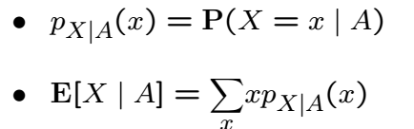
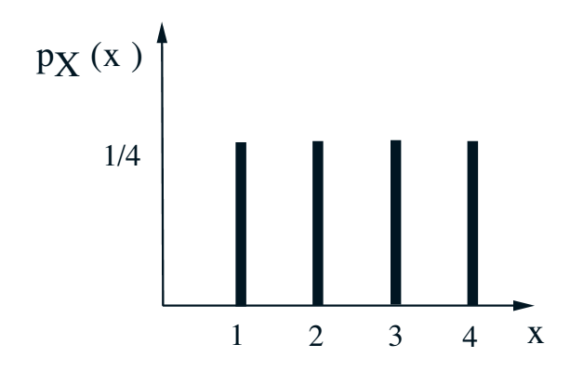
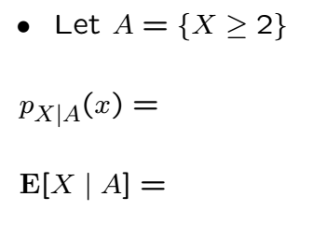
Conditioning PMF on Events

Slide 2
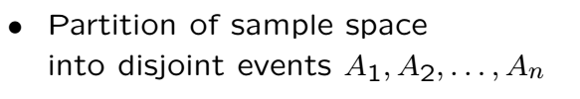
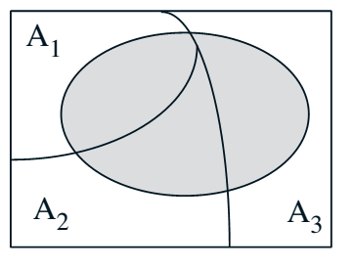
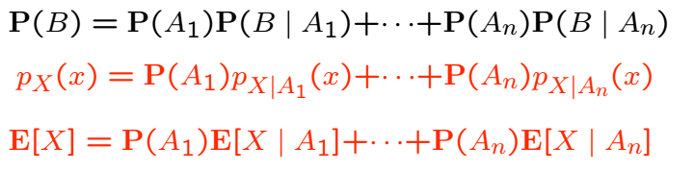
Total Expectation Theorem

Slide 3


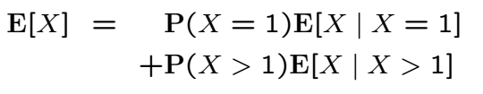

Example
is geometrically distributed
Compare with earlier derivation which required summation trick

Slide 4
Acknowledgements and Citations
Parts of these slides are adapted from the following resources:
Power Point Lecture Slides for the Textbook http://bcs.wiley.com/hebcs/Books?action=index&bcsId=8676&itemId=1118324560
John Tsitsiklis. 6.041 Probabilistic Systems Analysis and Applied Probability, Fall 2010. (Massachusetts Institute of Technology: MIT OpenCourseWare),http://ocw.mit.edu (Accessed 13 Apr, 2015). License: Creative Commons BY-NC-SA

